Slide 1
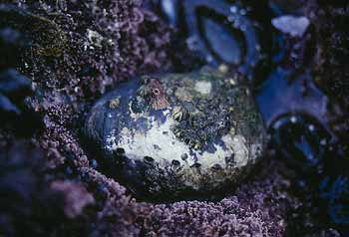
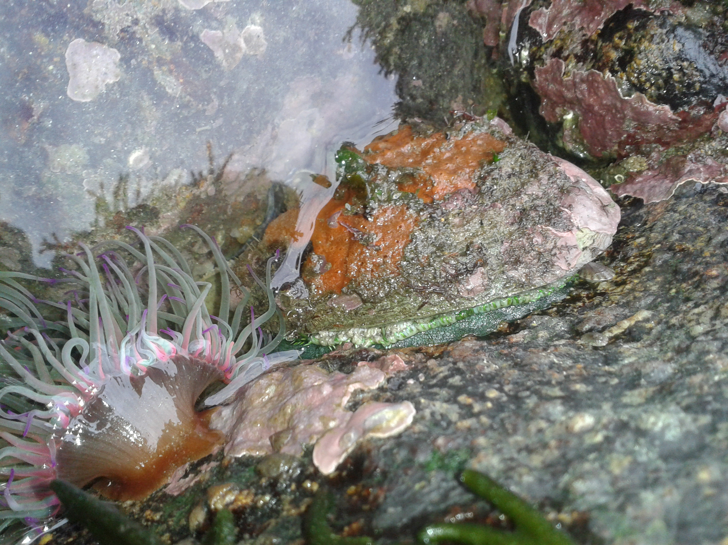
Project 3
Predicting the Age of Abalone using Machine Learning and Neural Networks
Group NoFloods
Amit Patel
Daniah Al Bayati
Roopa Patel
Samuel Parks
Steven Lee

Slide 2

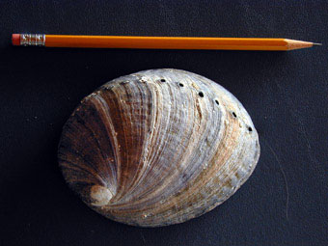
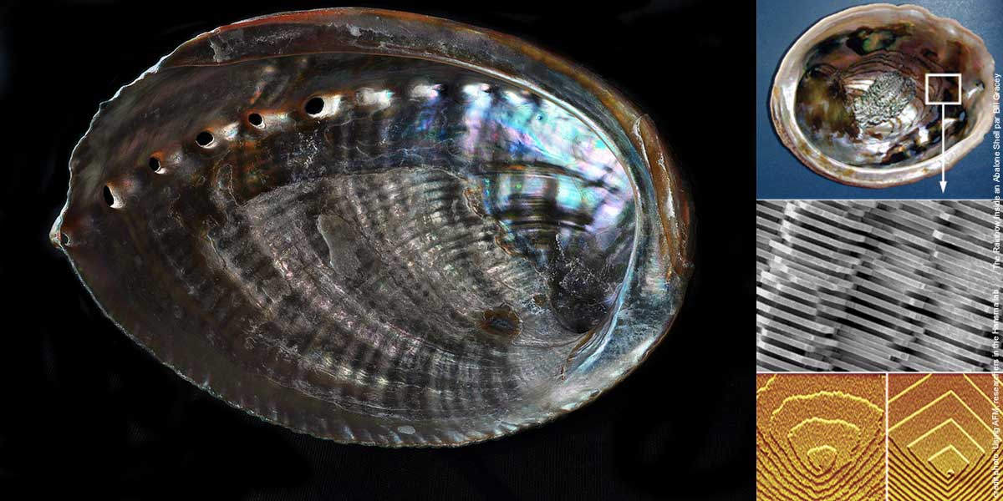
Project Goal
Predict the age of abalone using physical characteristics
Use Machine Learning and Neural Network models
vs

Slide 3
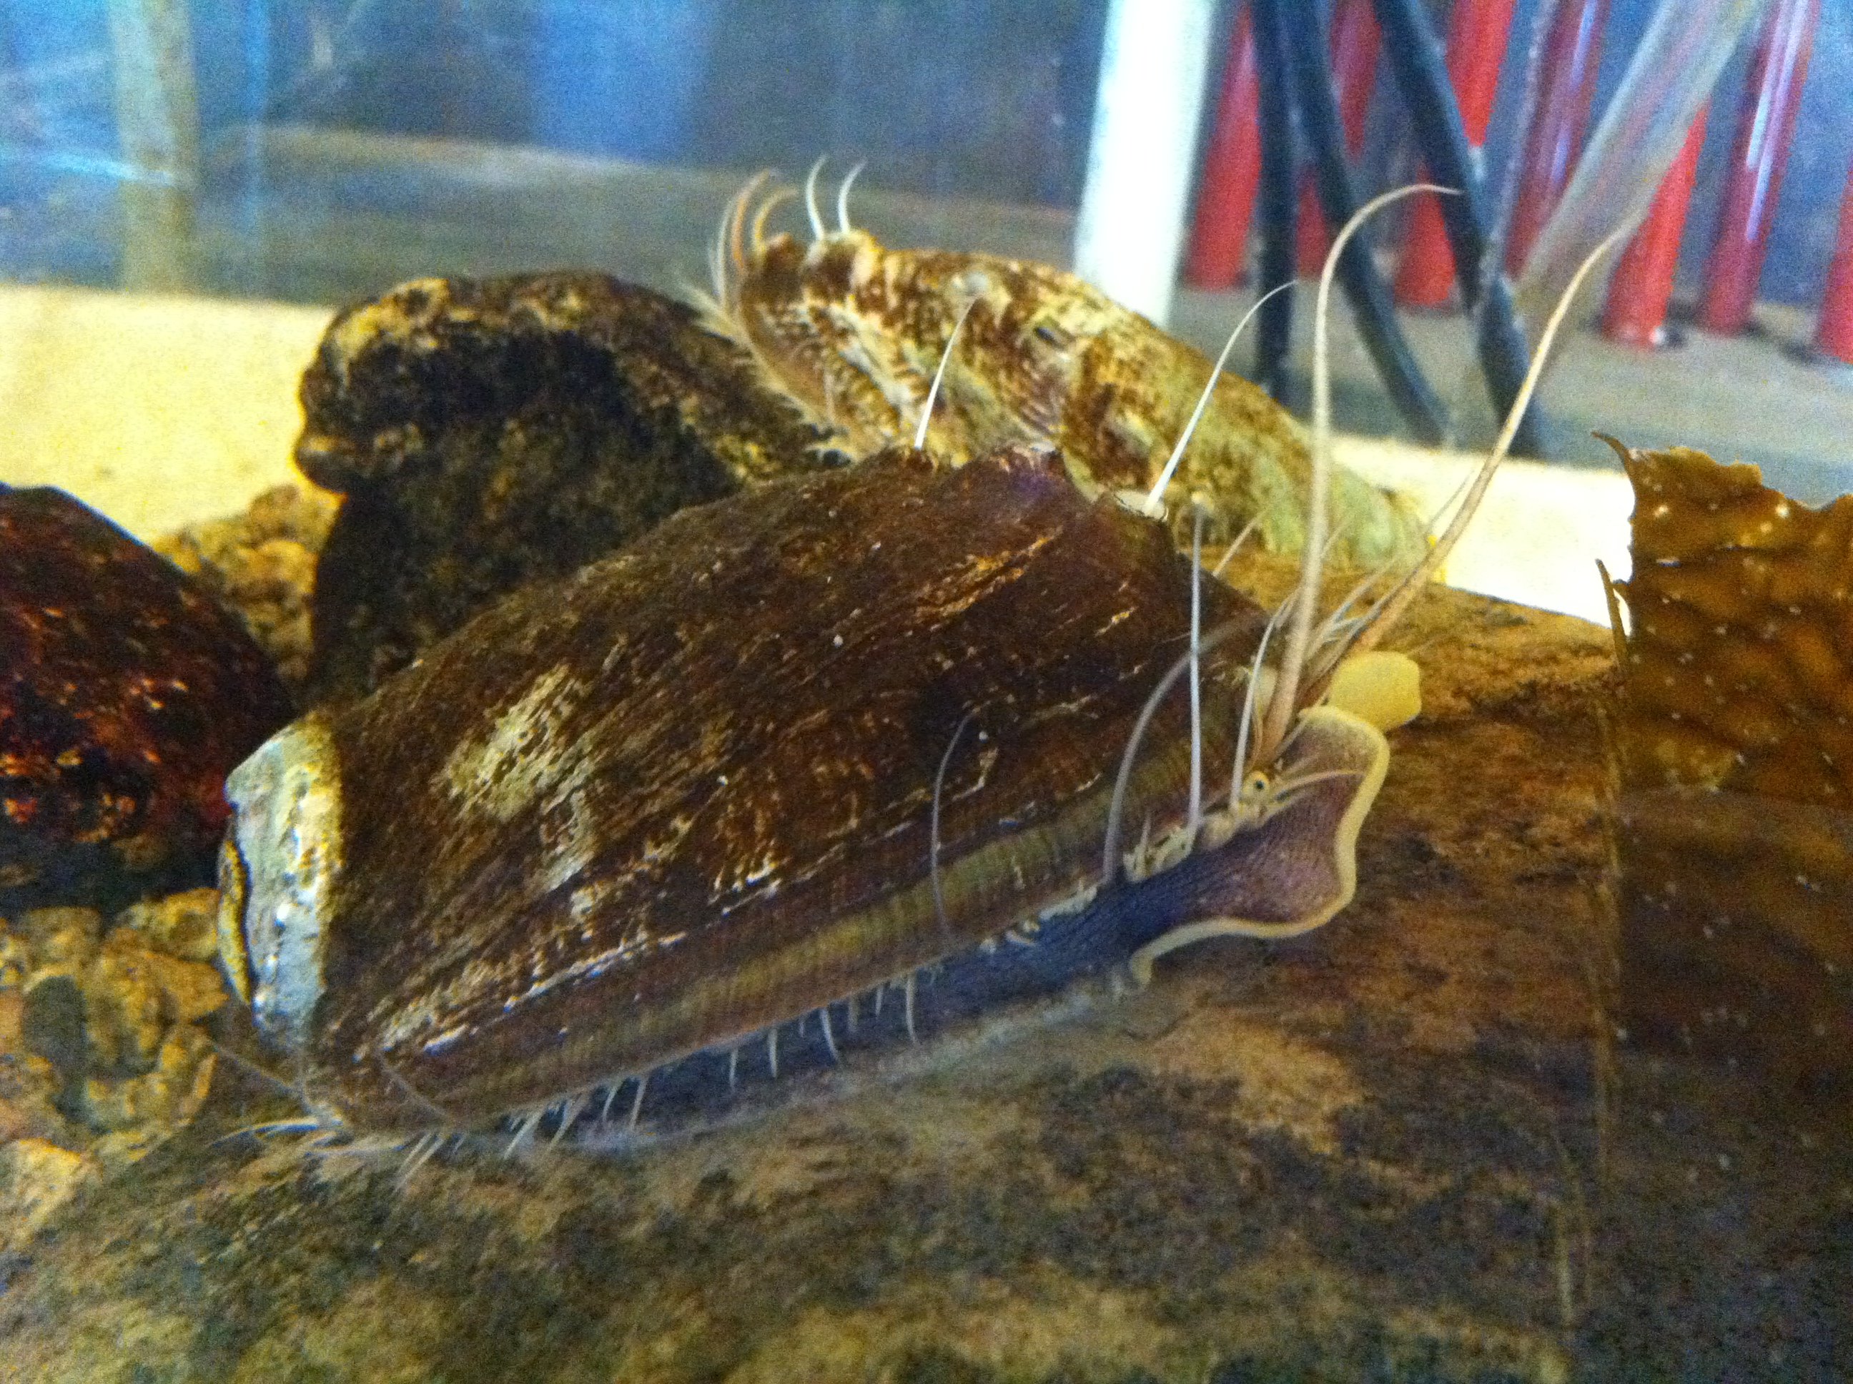
What is an abalone?
Abalone are marine snails
From Wikipedia, an abalone is a common name for any of a group of small to very large sea snails, marine gastropod molluscs in the family Haliotidae
Vary in length from 20mm – 200mm
Commonly used for food and jewelry

Slide 4
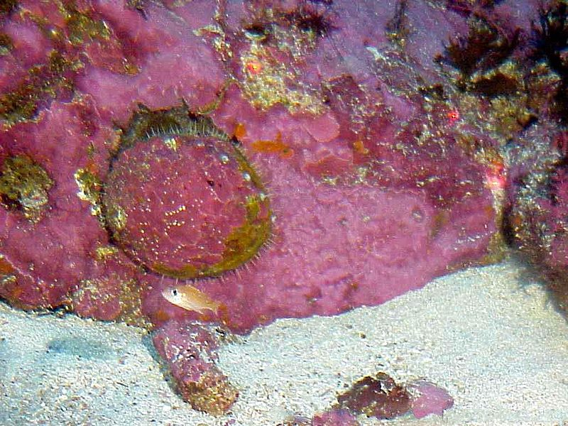
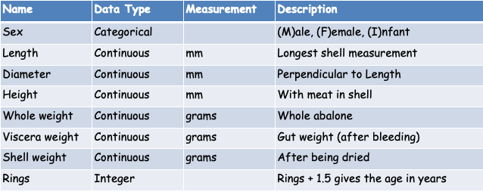
Data Source
University of California, Irvine (UCI) ML Repository https://archive.ics.uci.edu/ml/datasets/Abalone
4,177 rows with 8 attributes
Mostly continuous variables, with one categorical and one integer
For our models, we are trying to predict “Rings” (supervised model)
Age is directly related to Rings: Age = Rings + 1.5

Slide 5
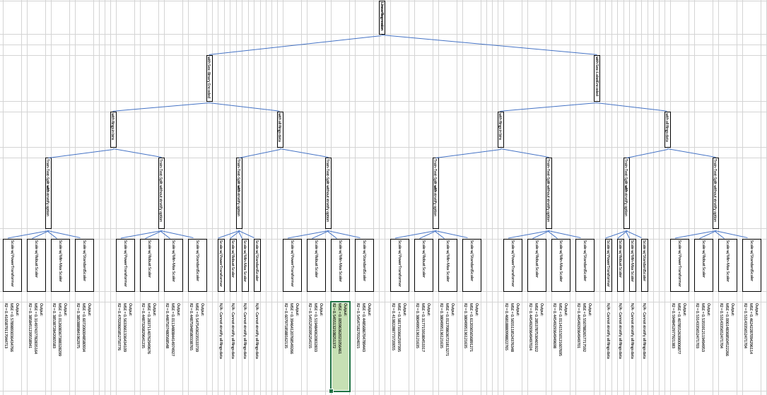
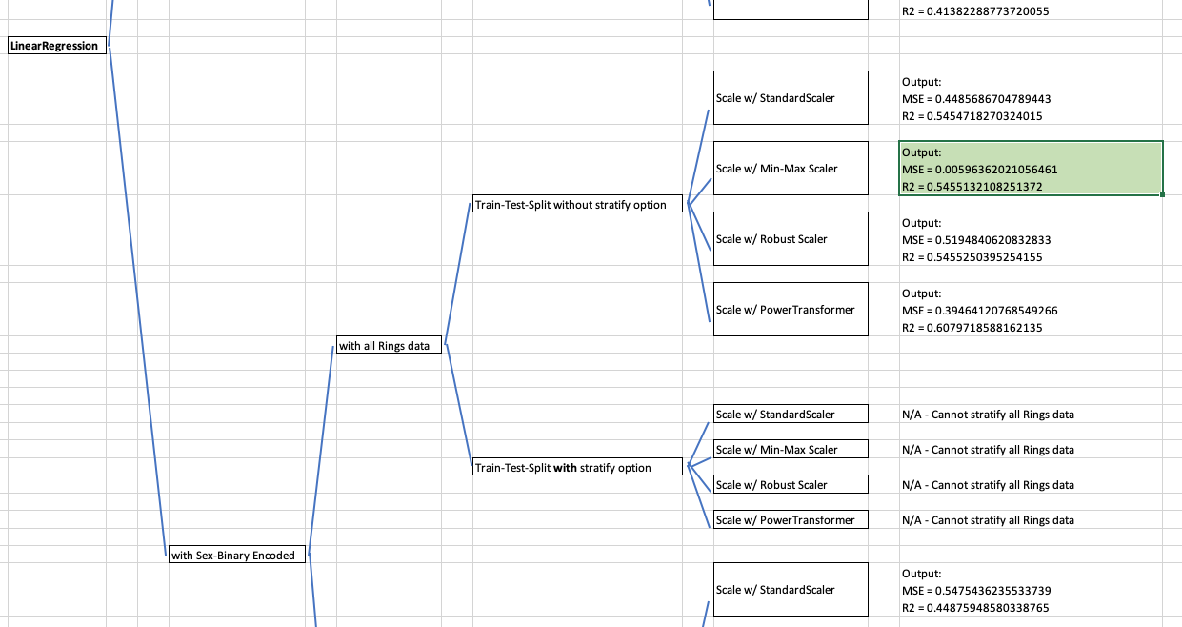
Our Methods
Data Preprocessing
ML Modeling
Linear Regression
Classification
H2O AutoML
Neural Networks
Simple
Deep

Slide 6
Section break (Speaker change)

Slide 7
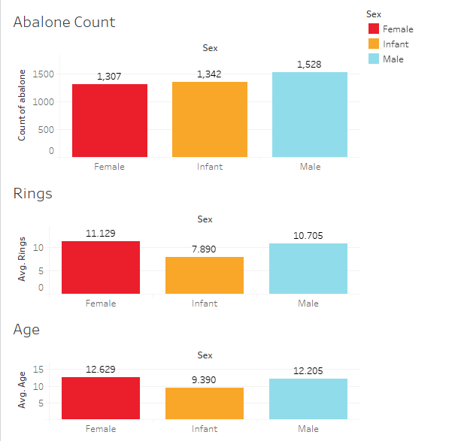
Descriptive Analytics
Count of abalone by sex
Average number of rings by sex
Average age by sex

Slide 8
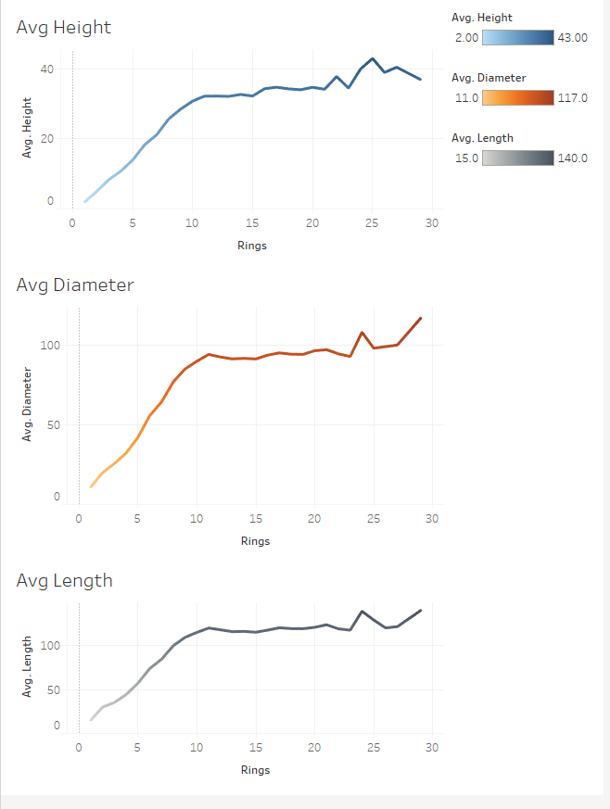
Descriptive Analytics
Average height by number of rings
Average diameter by number of rings
Average length by number of rings

Slide 9
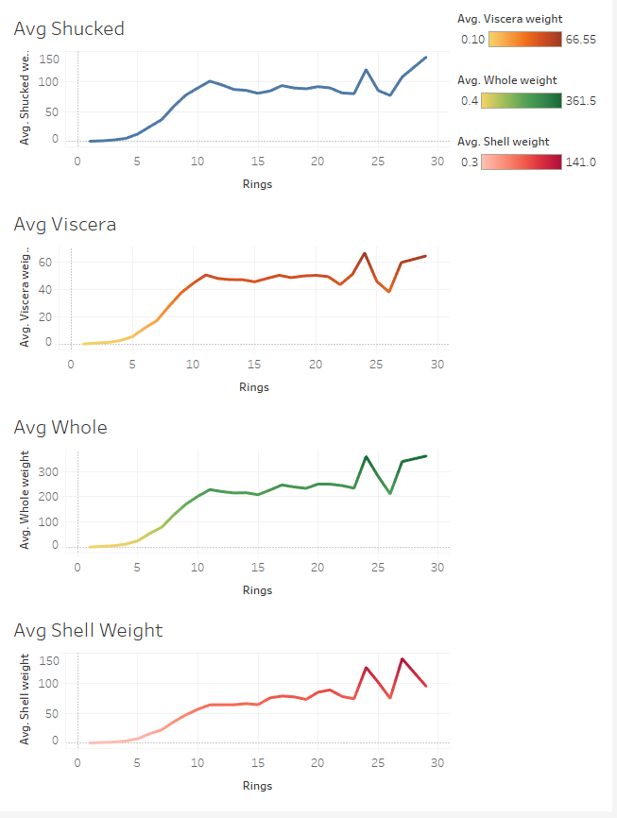
Descriptive Analytics
Average weights by number of rings
Shucked weight
Viscera (gut) weight
Whole weight
Shell weight

Slide 10
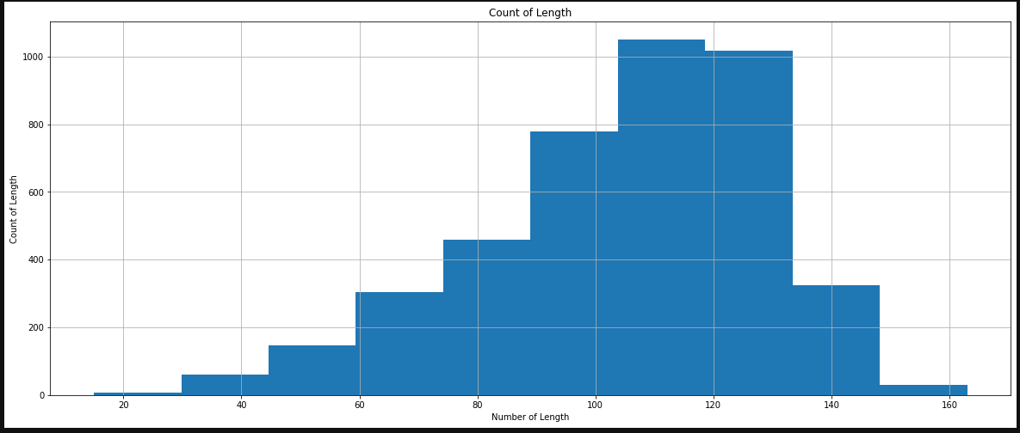
Descriptive Analytics
Histogram of Length

Slide 11
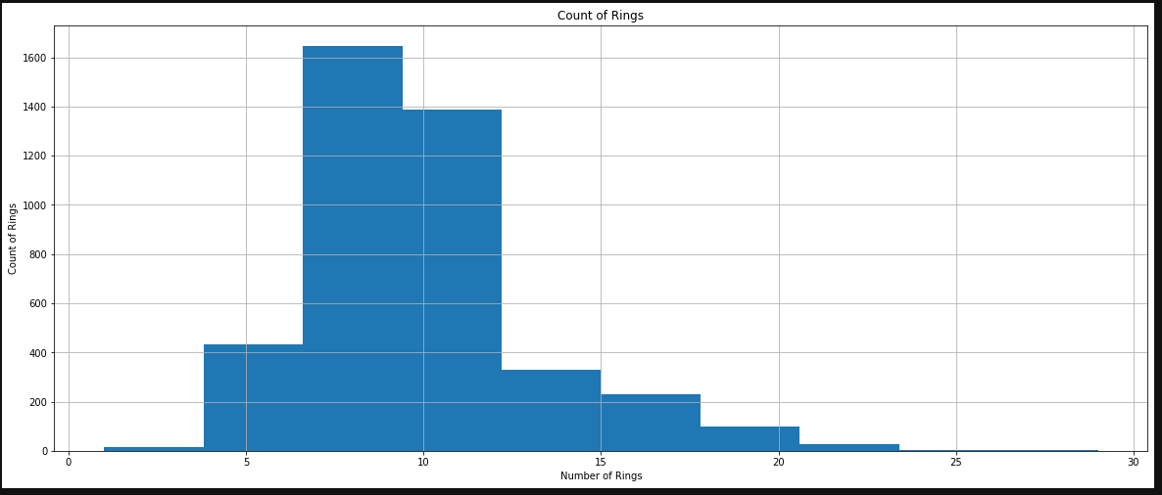
Descriptive Analytics
Histogram of Rings
Data imbalance: Ring numbers are not evenly represented

Slide 12
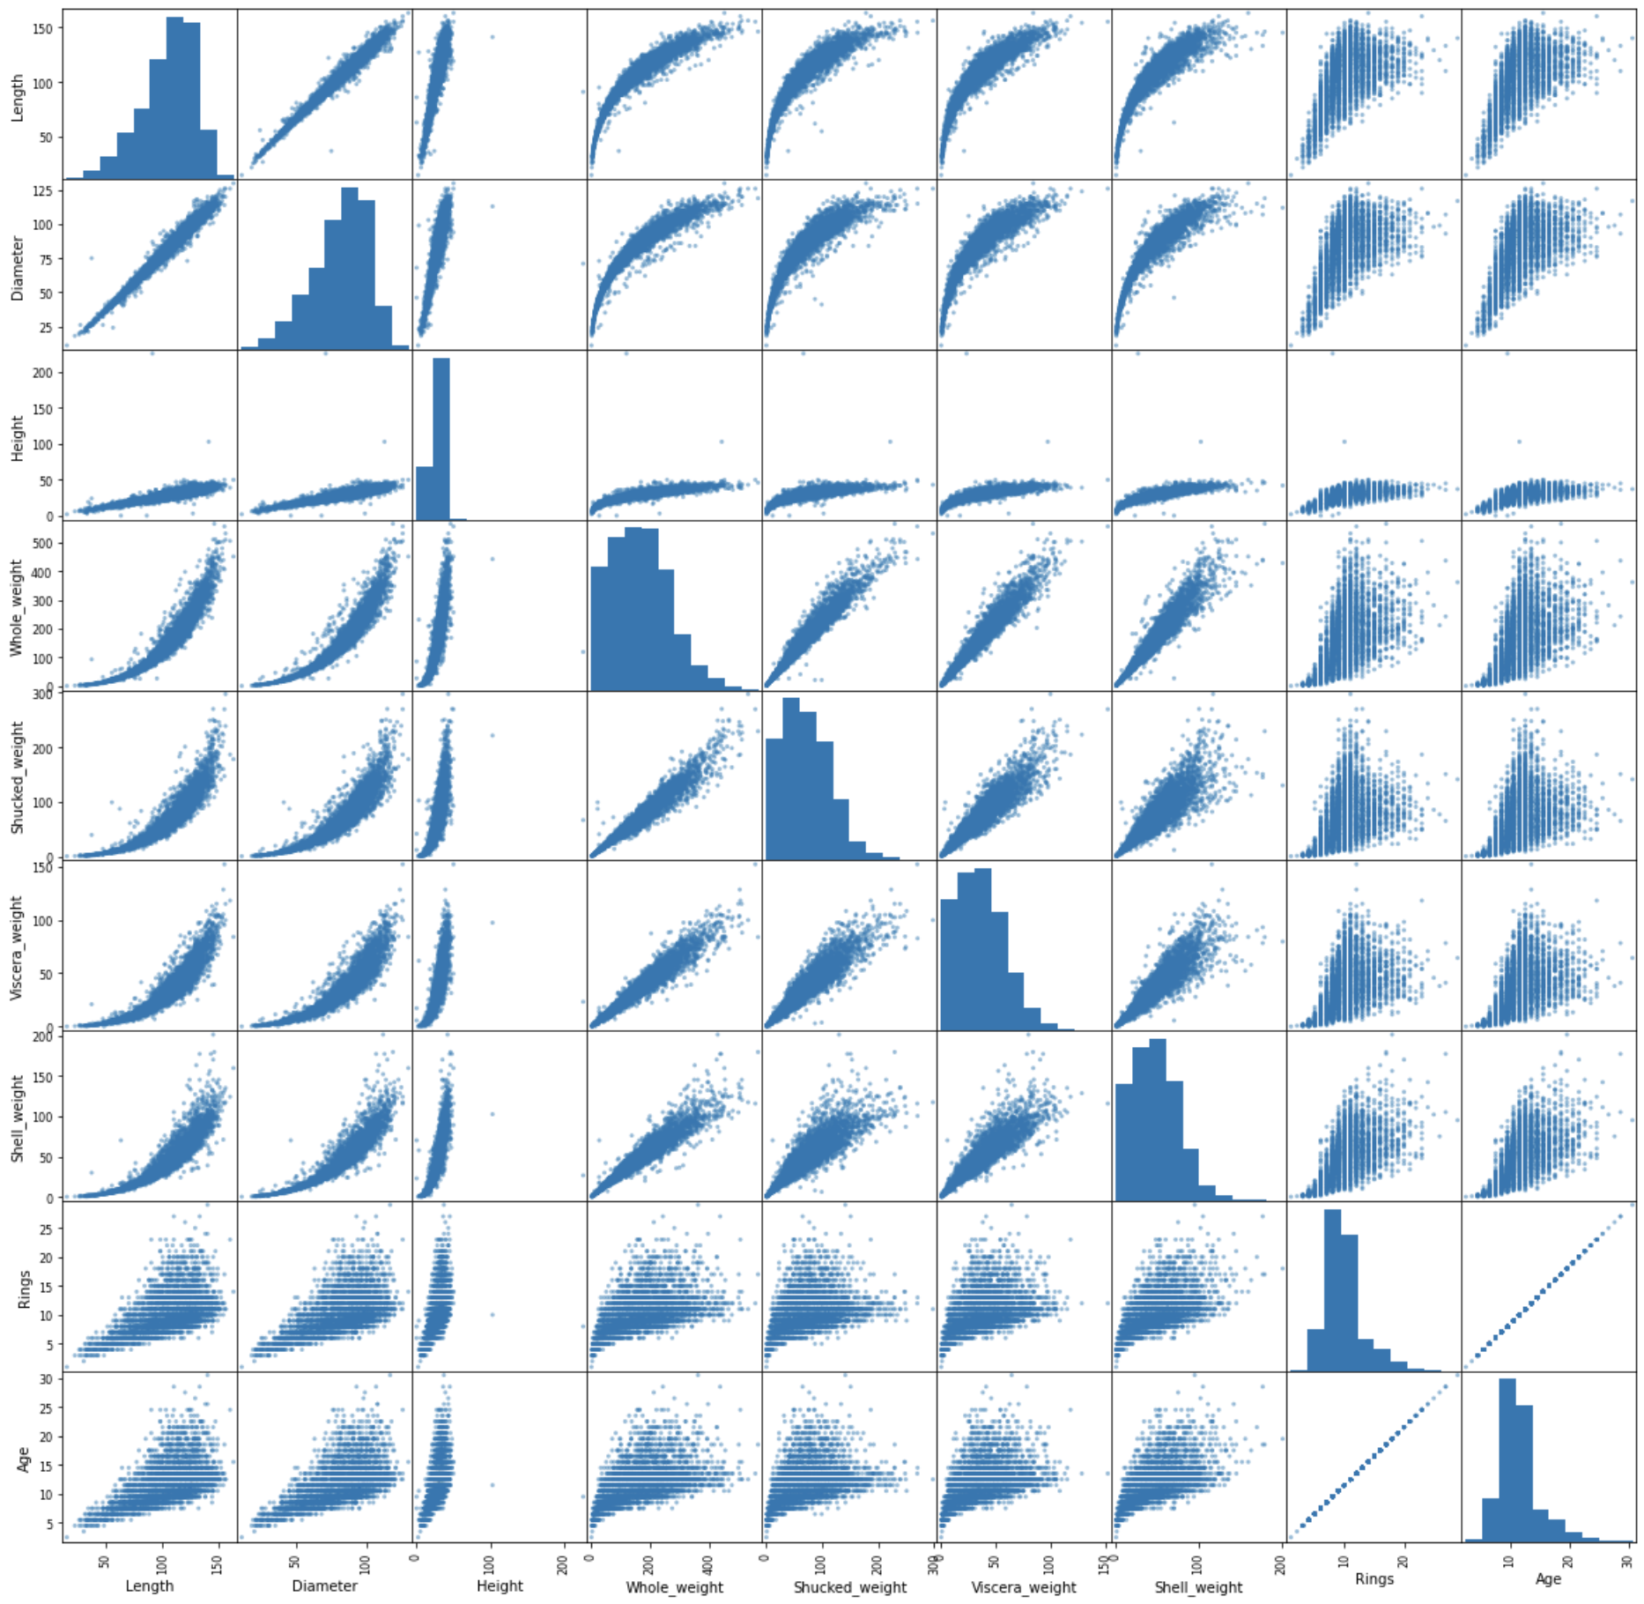
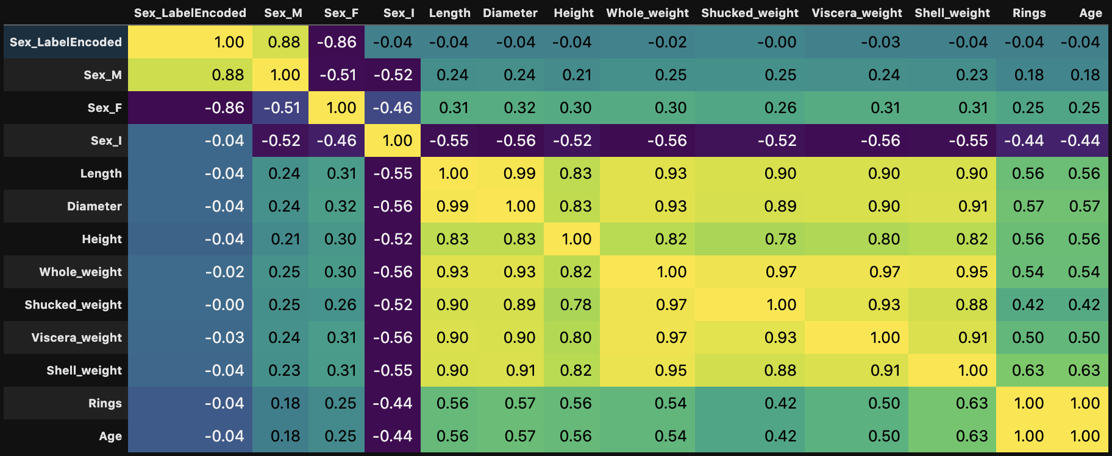
Descriptive Analytics
Scatter Matrix (pictured right)
Correlation Matrix (below)

Slide 13
Section break (Speaker change)

Slide 14
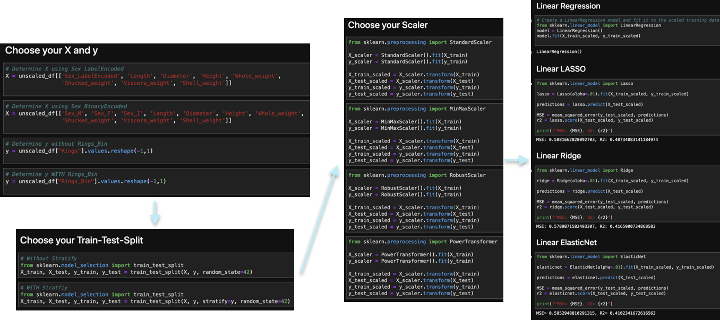
Linear Regression Models: The Process

Slide 15
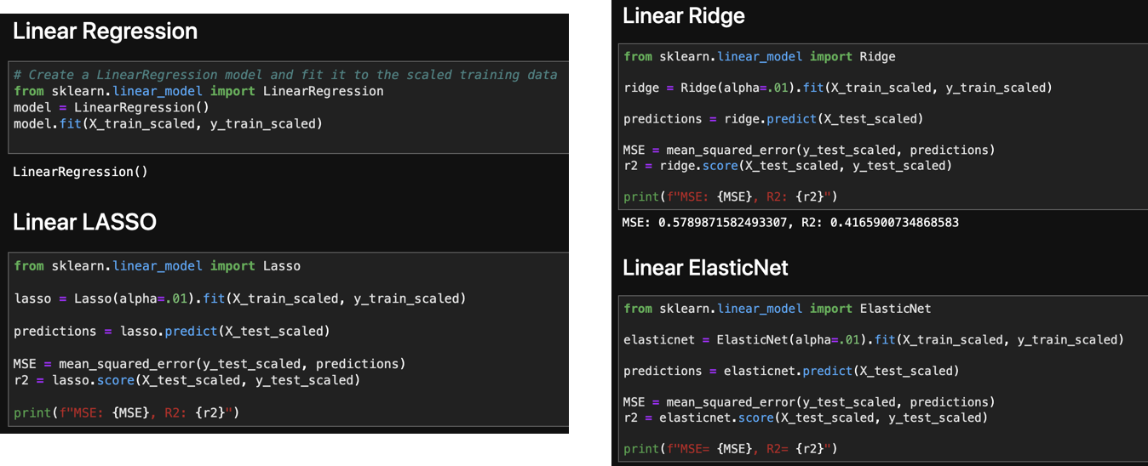
Linear Regression Models: Model-Fit-Predict-Score

Slide 16
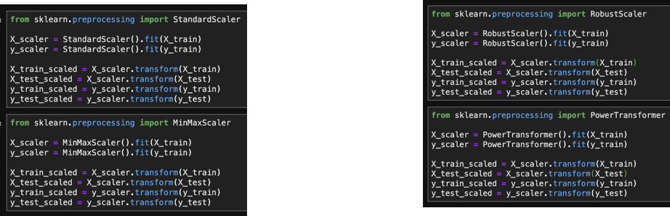
Linear Regression Models: The Scalars

Slide 17
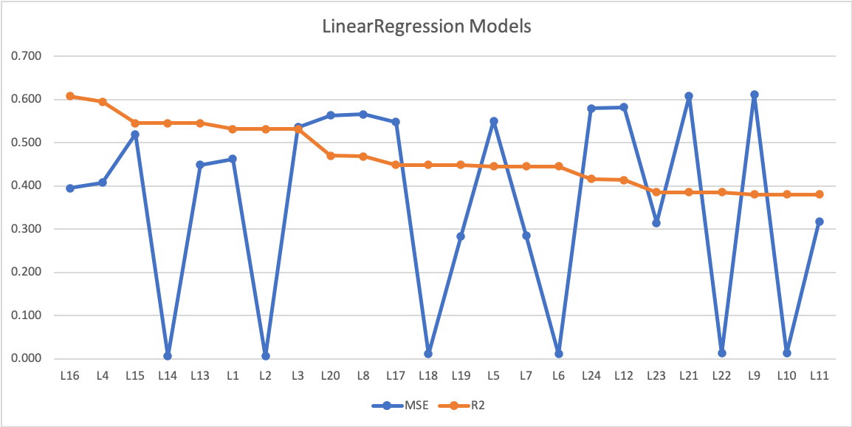
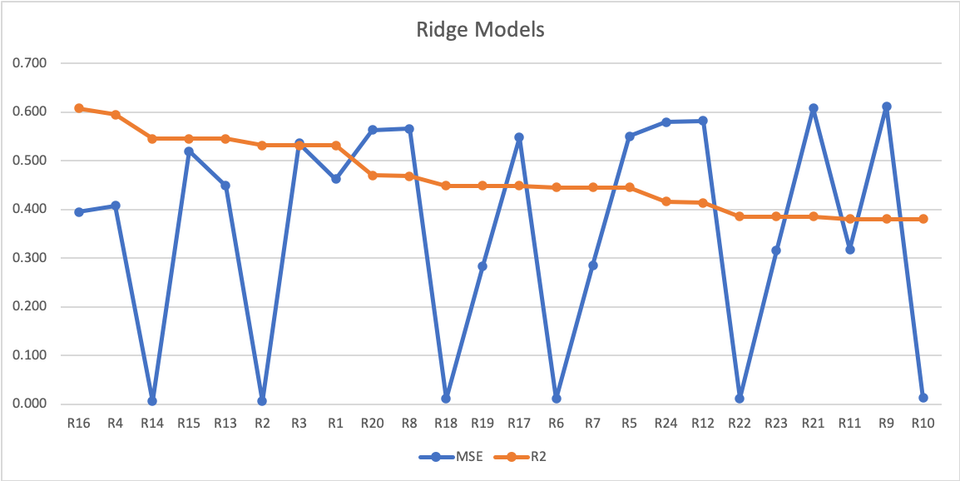
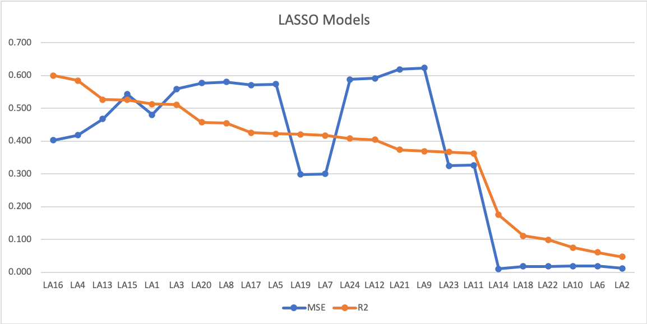
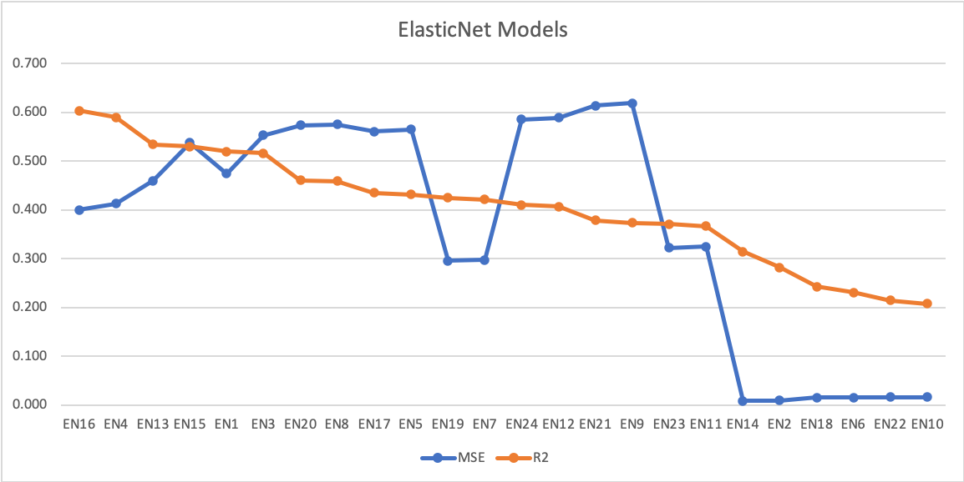
Linear Regression Models: Per-Model Performance Summary

Slide 18
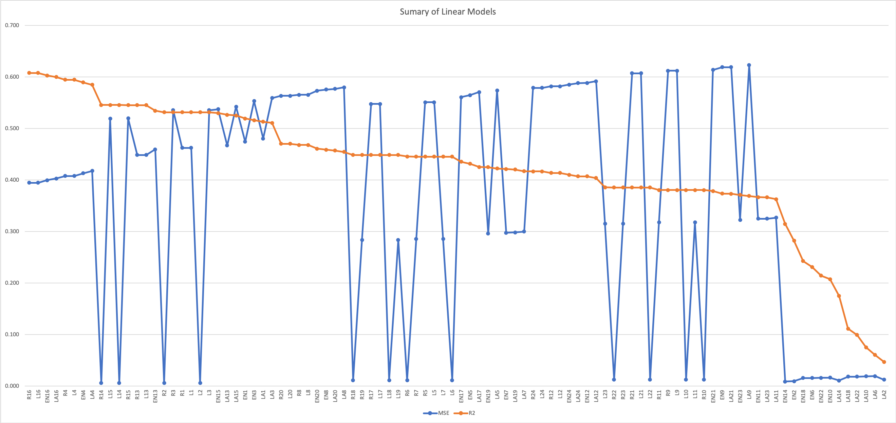
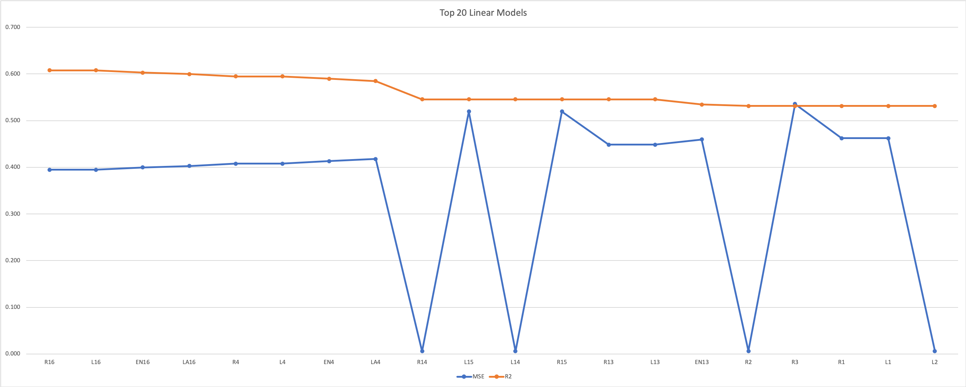
Linear Regression Models: Combined Performance Summary

Slide 19
Section break (Speaker change)

Slide 20
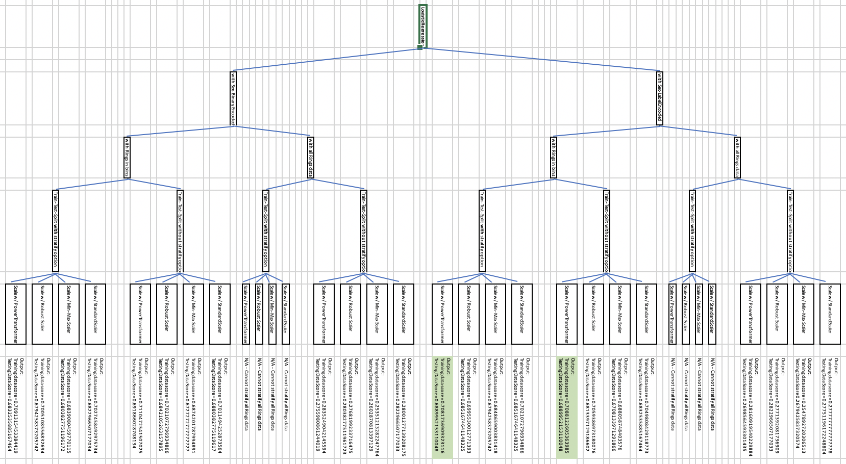
Classification Models
We ran the following scikit-learn classification models:
LogisticRegression
KNN
RandomForest
SVM
Our top classification models yielded testing scores ~70.00%
Notes:
-Here we built a series of classifiers to predict the age of an Abalone, we targeted the ‘Rings’ of Abalone which is a discrete integer from 1 – 29.
-surpassing the conventional machine learning algorithms as we incorporated methods for preventing over-fitting and methods for normalizing the output throughout the network.

Slide 21
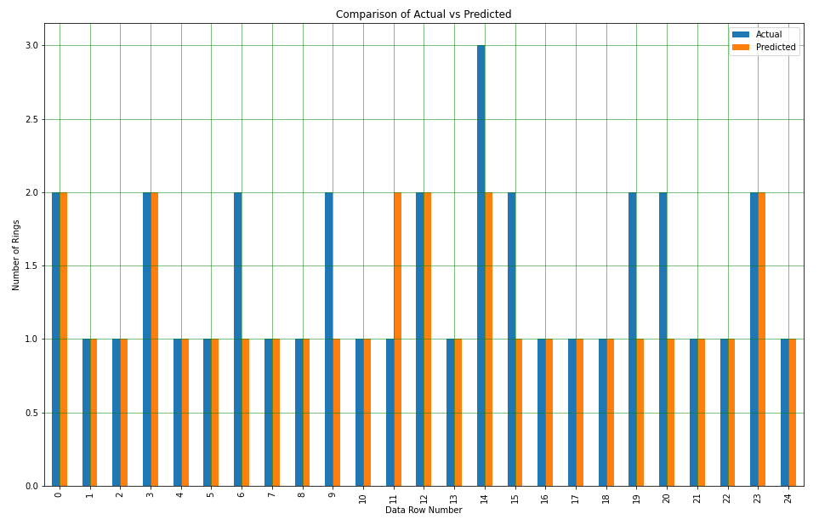
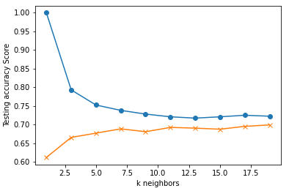
Classification Models
LogisticRegression: predicts a discrete output or category using an activation function
KNN: algorithms use data and classify new data points based on similarity measures
Notes:
-Here we built a series of classifiers to predict the age of an Abalone, we targeted the ‘Rings’ of Abalone which is a discrete integer from 1 – 29.
-surpassing the conventional machine learning algorithms as we incorporated methods for preventing over-fitting and methods for normalizing the output throughout the network.

Slide 22
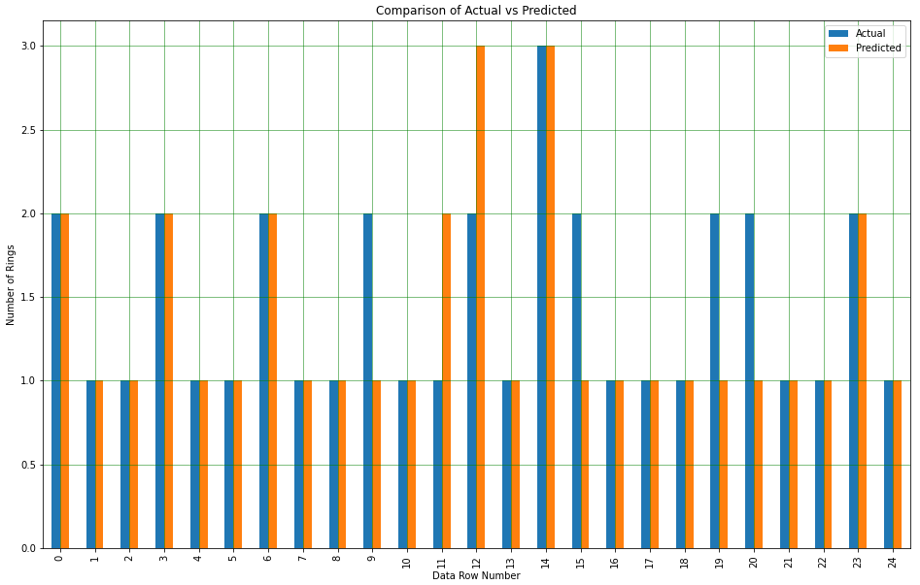
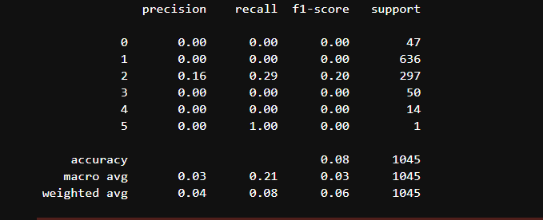
Classification Models
RandomForest Classifier: an ensemble method for classification or regression which combines multiple decision trees
SVM Classifier: finds the optimal hyperplane that separates the data points as much as possible

Slide 23
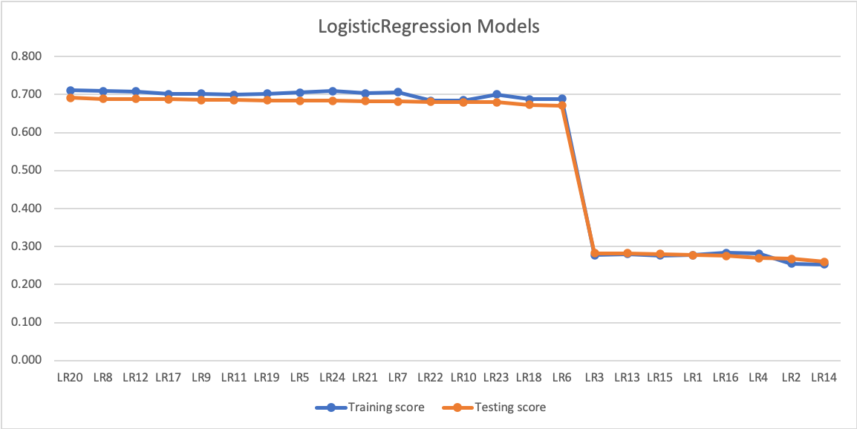
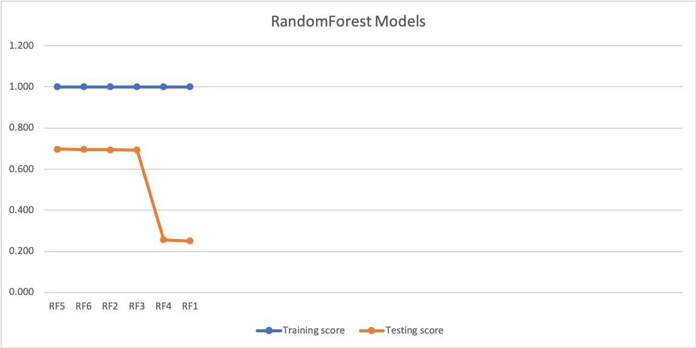
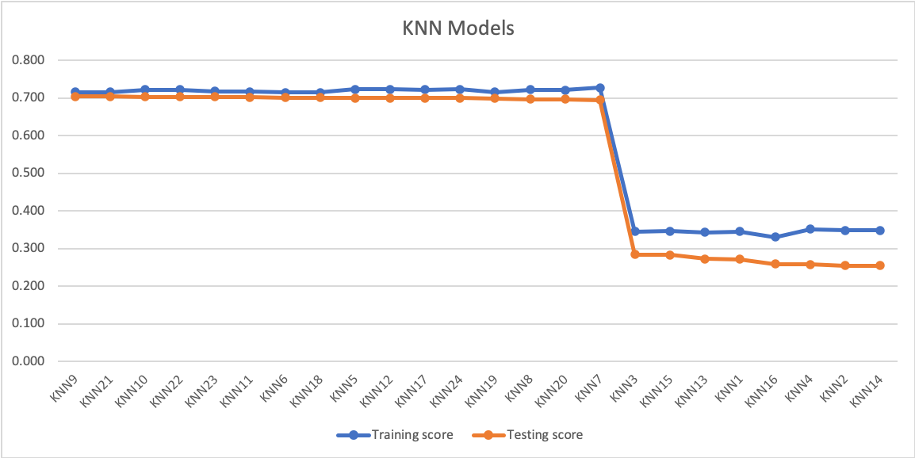
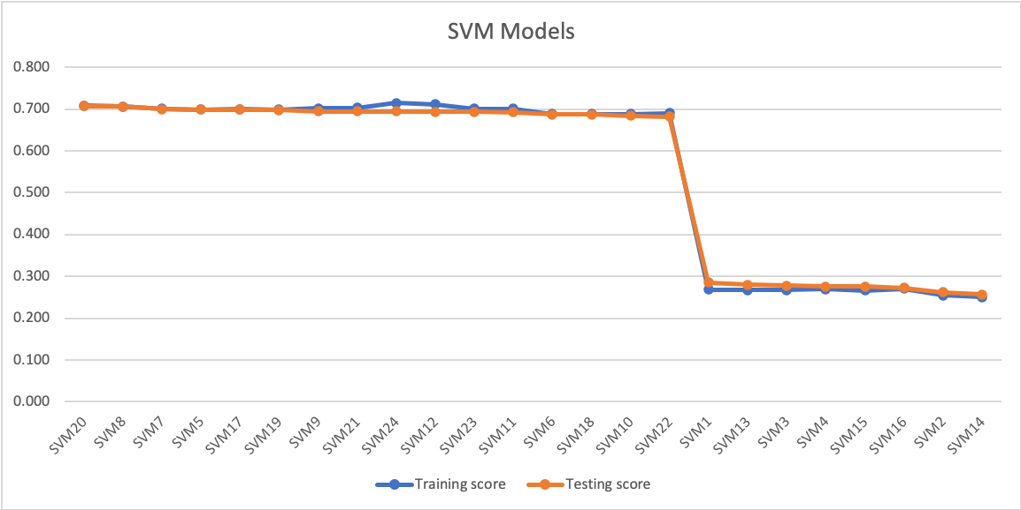
Classification Models: Per-Model Performance Summary

Slide 24
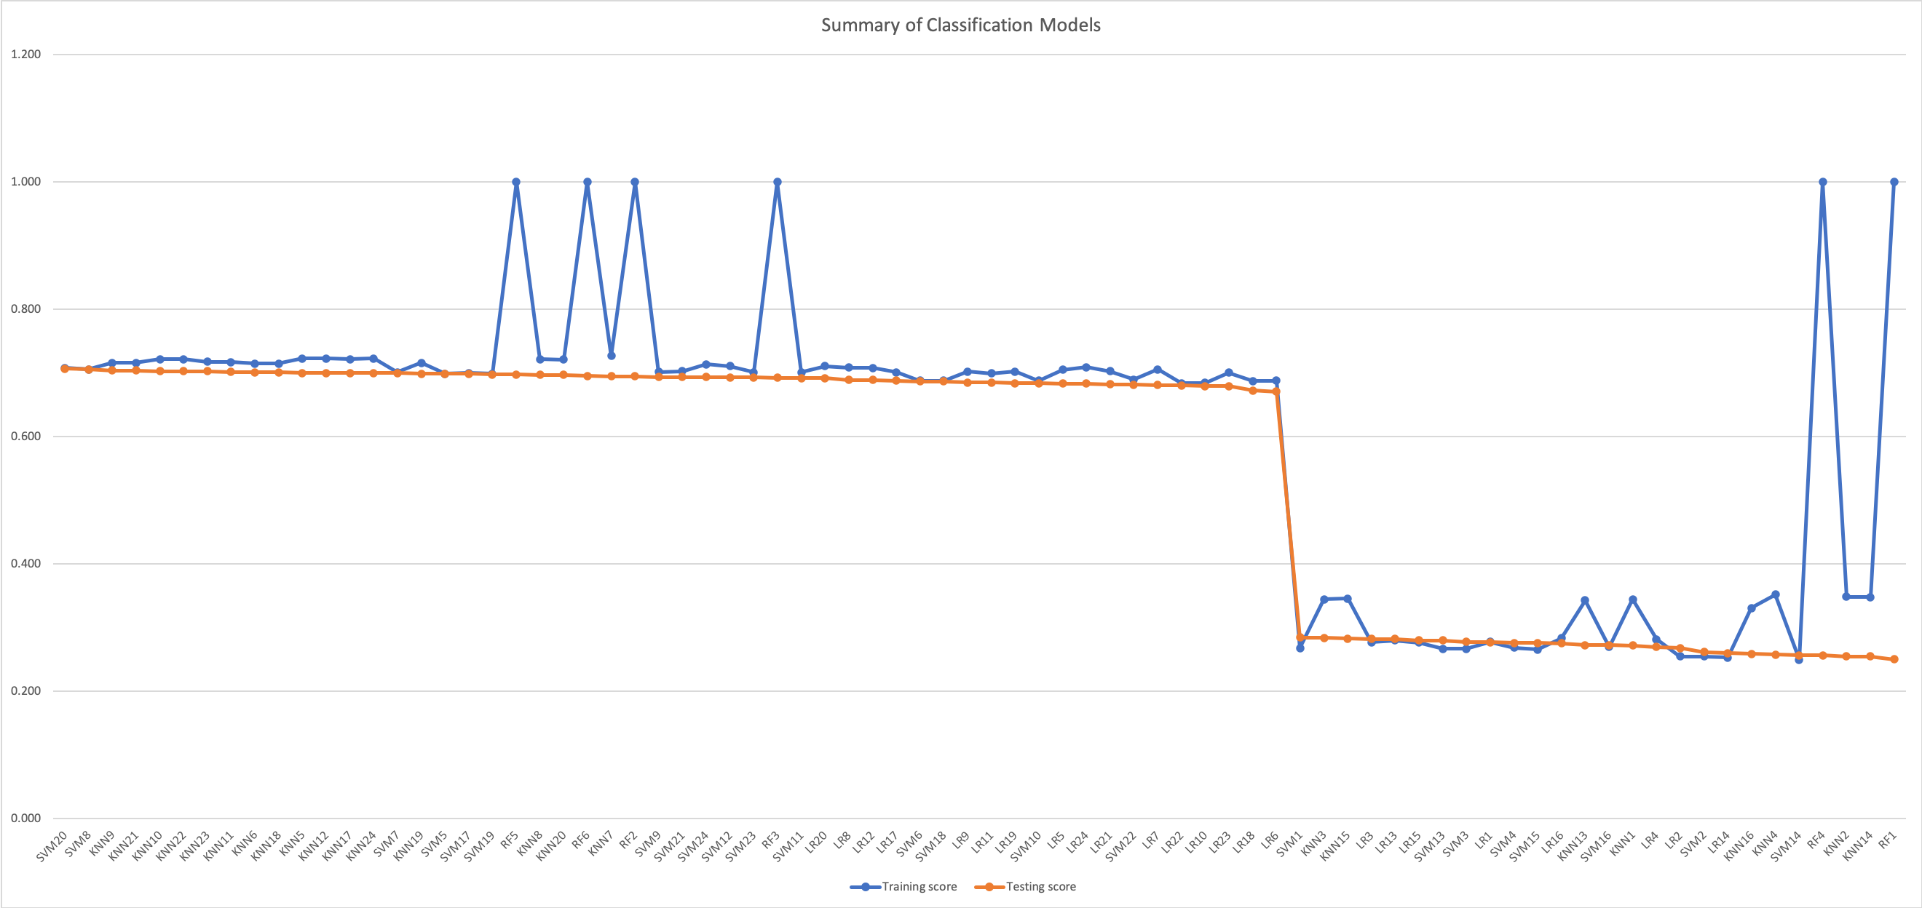
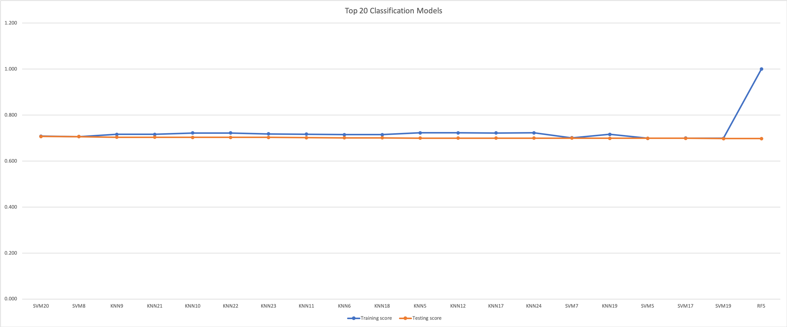
Classification Models: Combined Performance Summary

Slide 25
Section break (Speaker change)

Slide 26
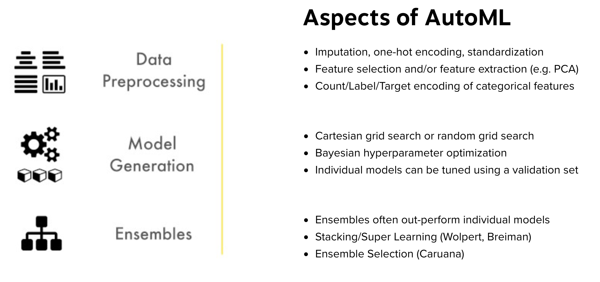
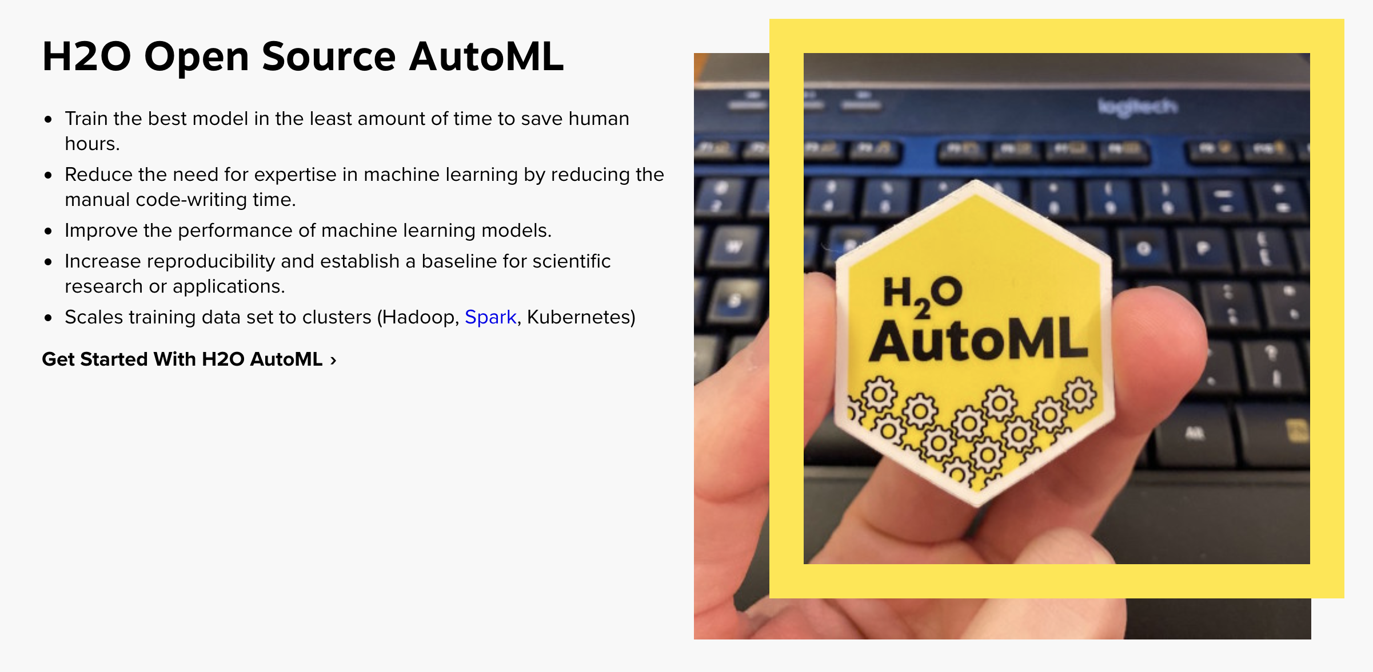

H2O AutoML: What is it?
From https://www.h2o.ai/products/h2o-automl/:
AutoML or Automatic Machine Learning is the process of automating algorithm selection, feature generation, hyperparameter tuning, iterative modeling, and model assessment

Slide 27
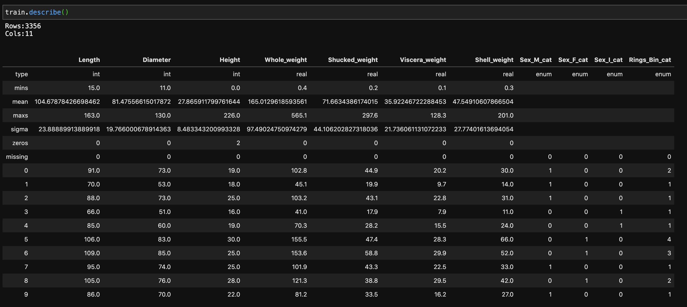
H2O AutoML: Preprocessing and Train-Test-Split
Usual data preprocessing, but H2OFrames are required (like pandas dataframes)
Train-Test-Split uses H2O’s split_frame() method
Categorical variables types need to be ‘enums’ using .asfactor()

Slide 28
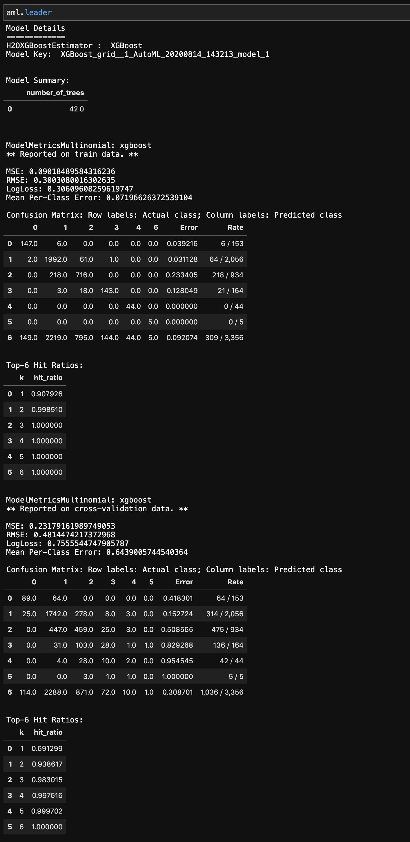
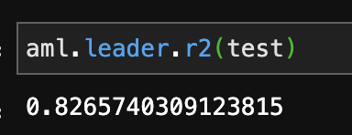
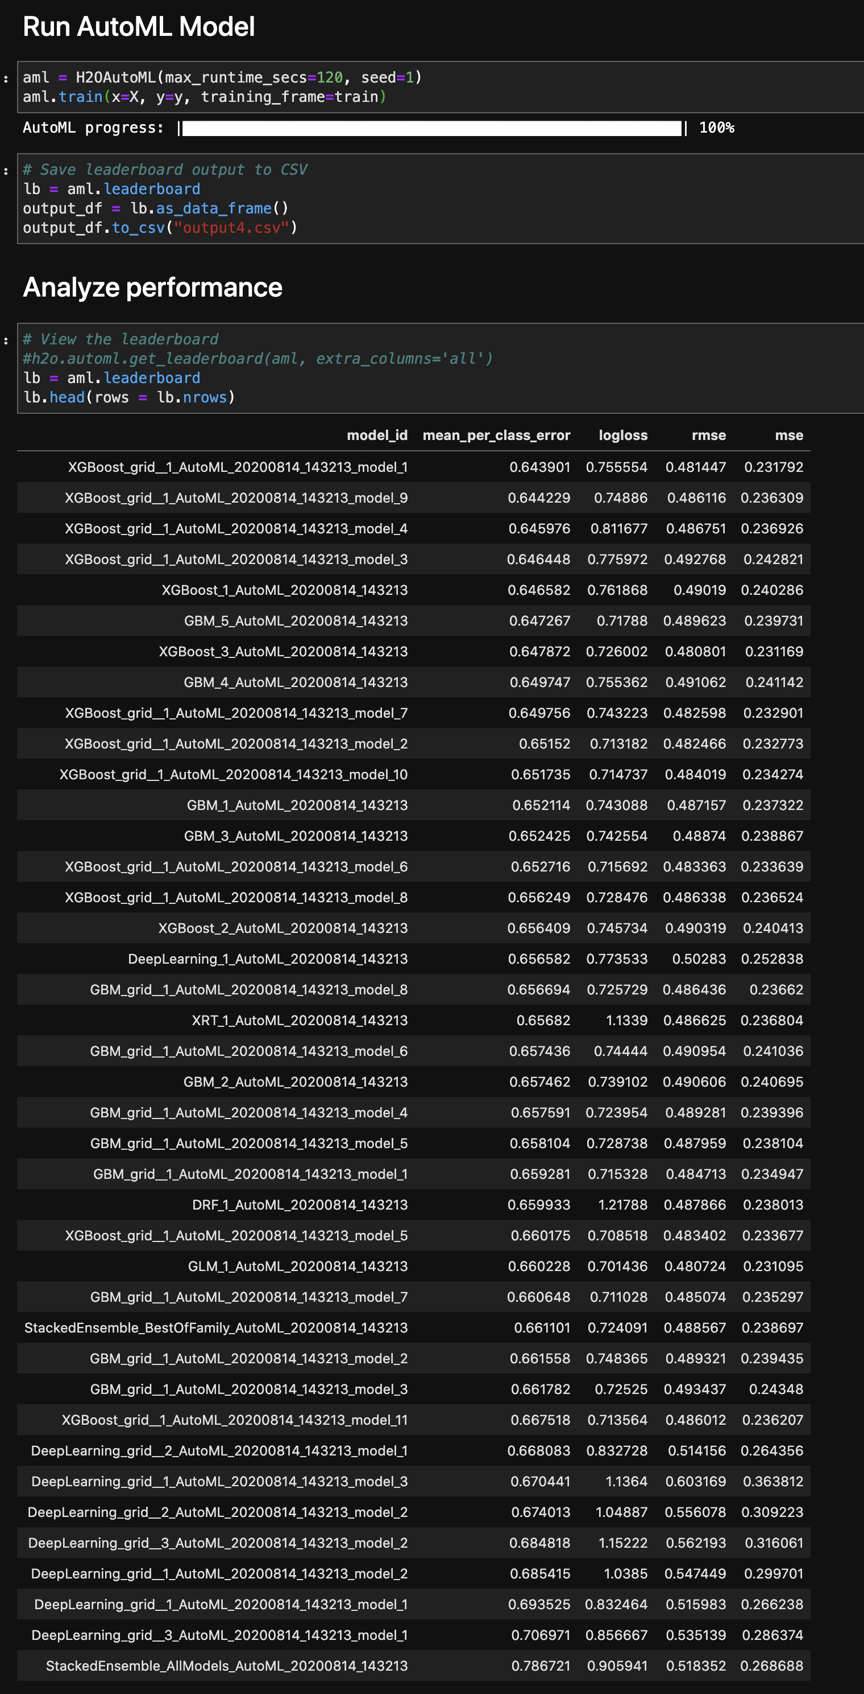
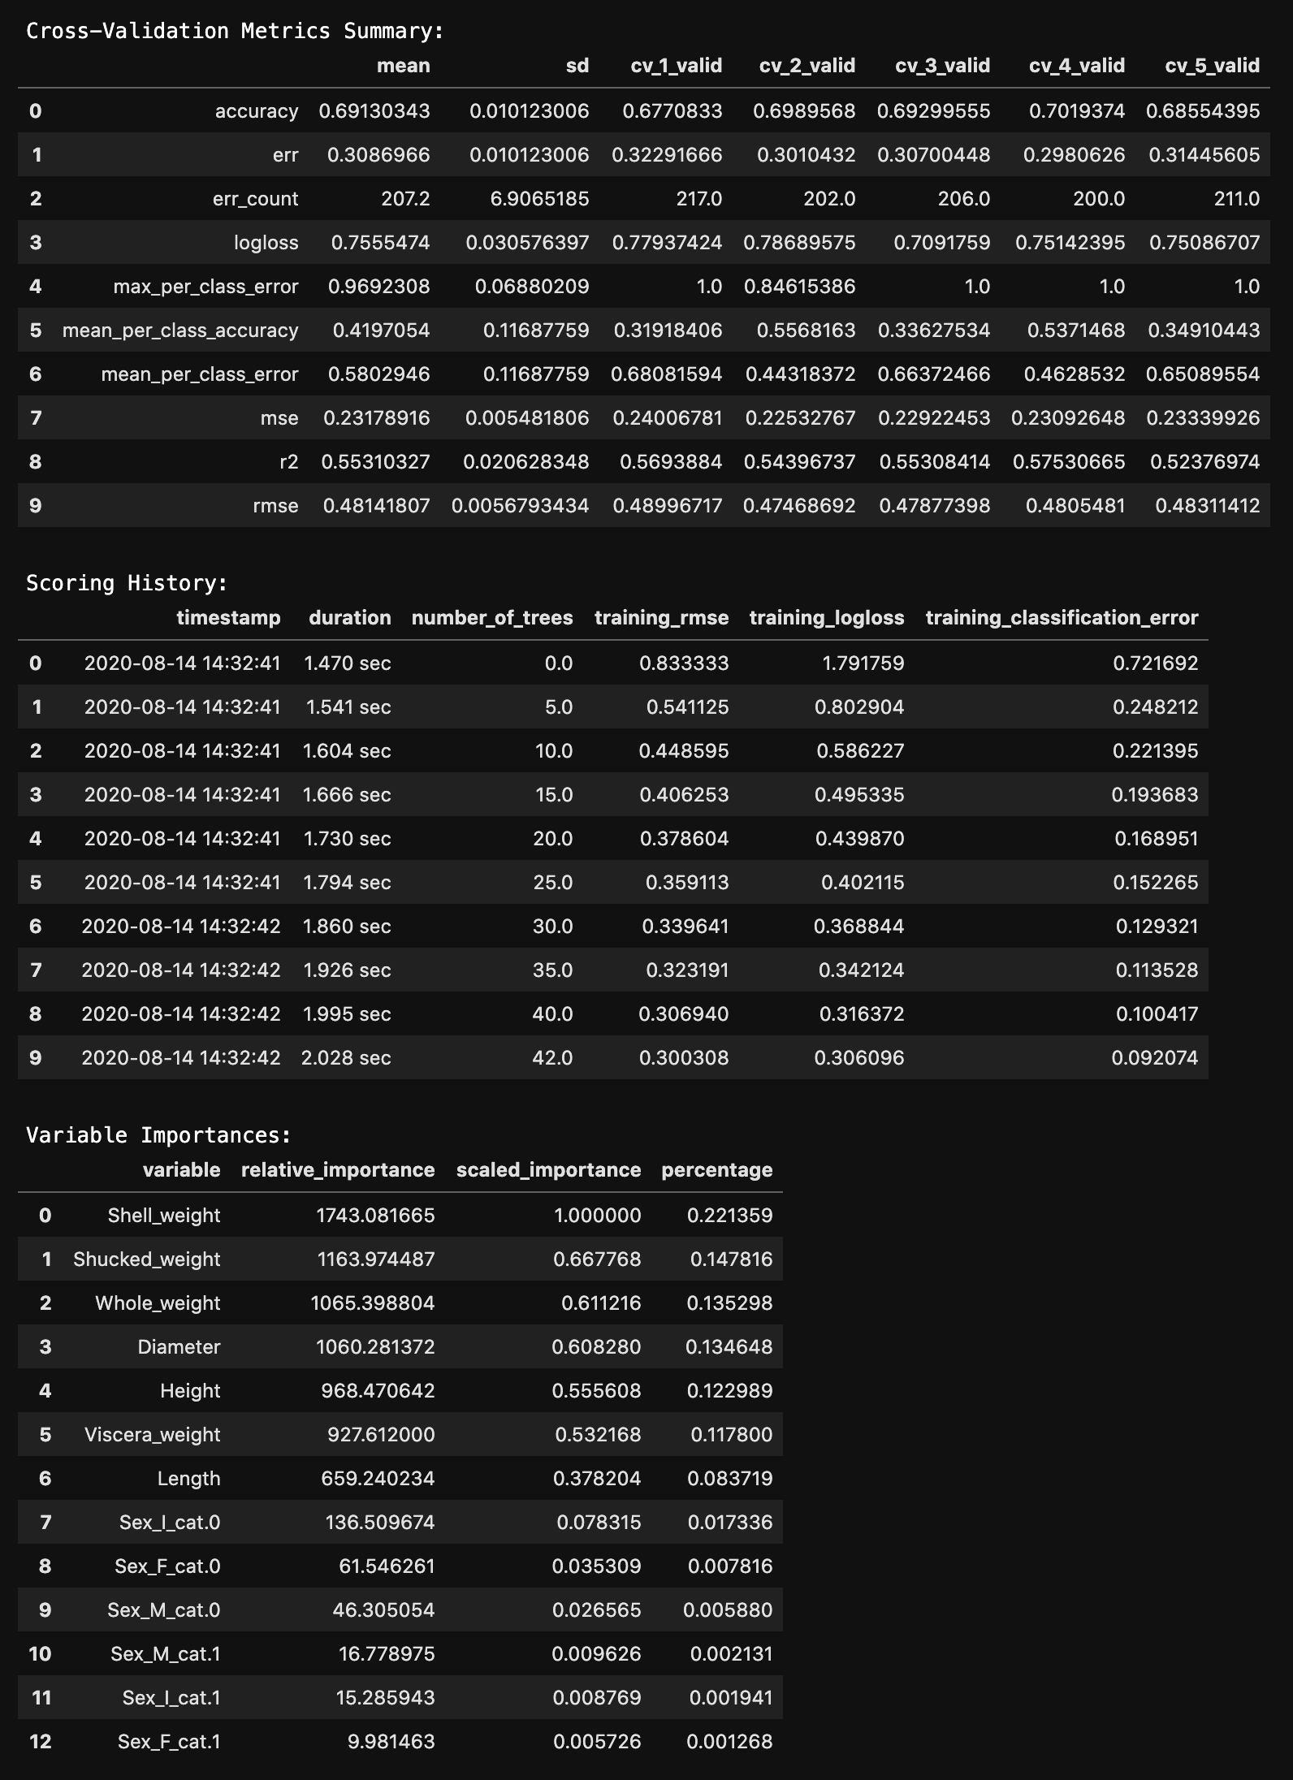
H2O AutoML: Training and the Leaderboard
After training the model, the leaderboard ranks models
You can further drill-down into the leader’s performance

Slide 29
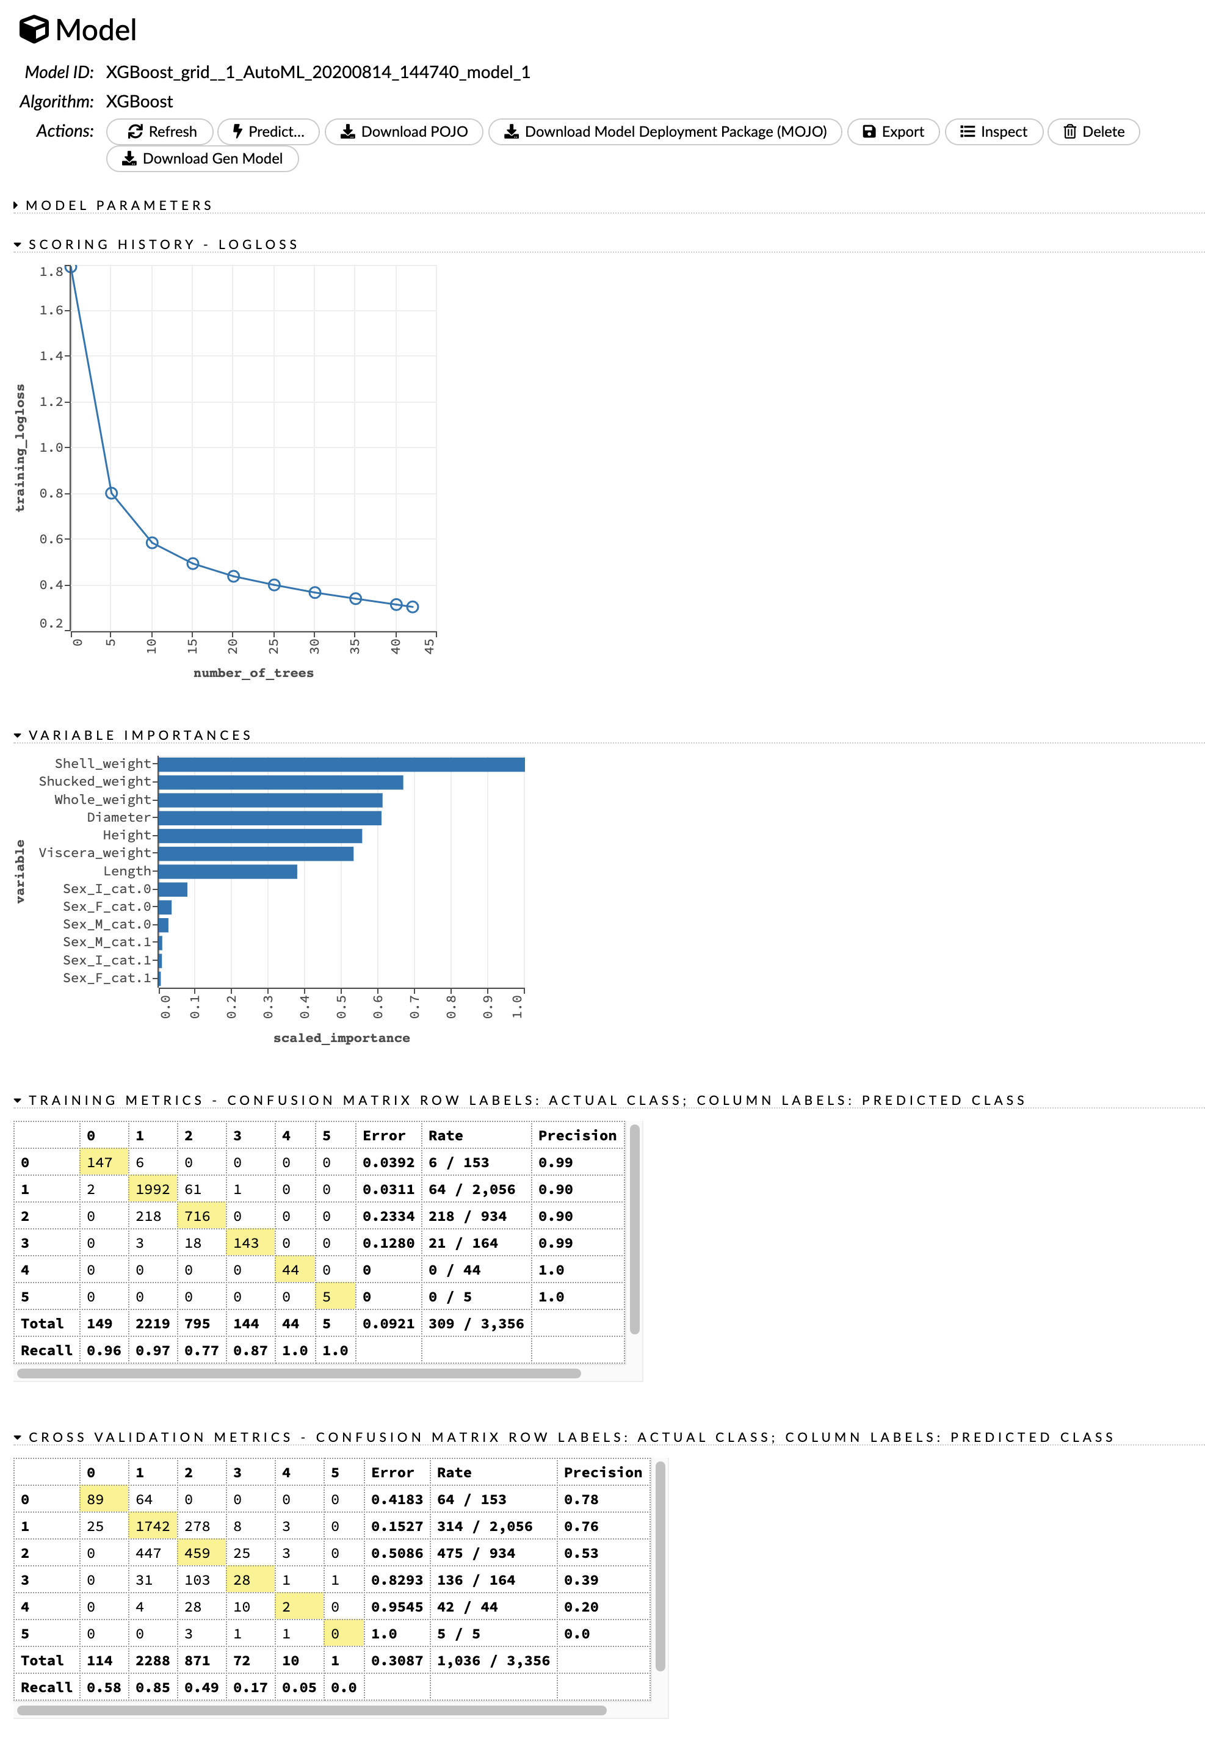
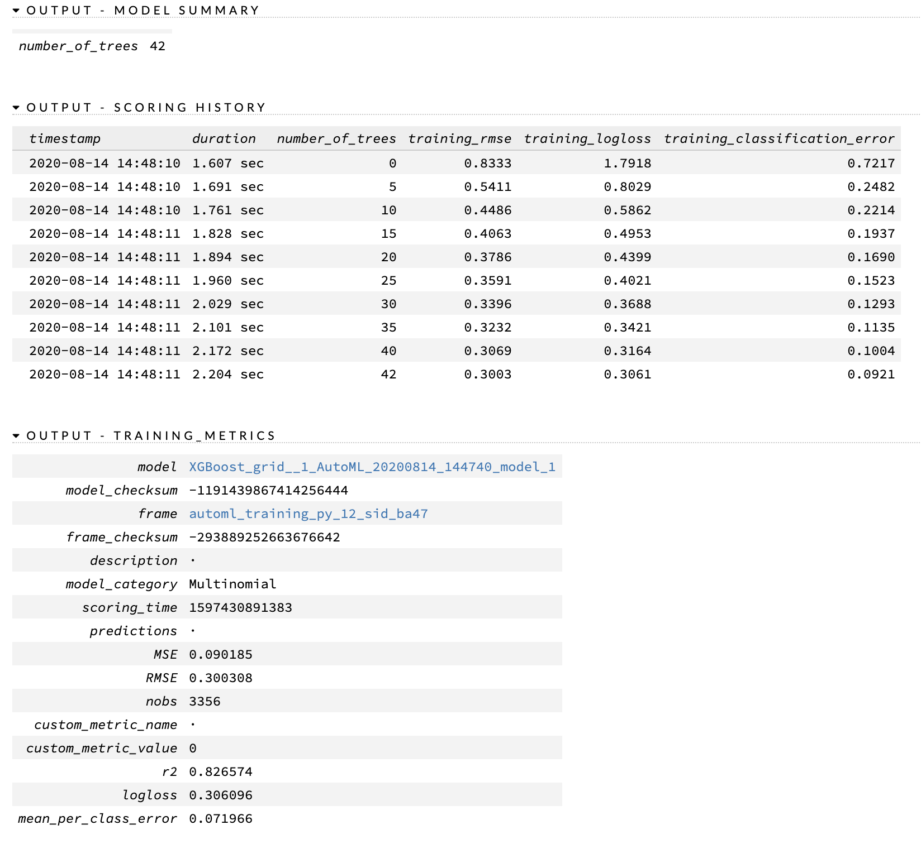
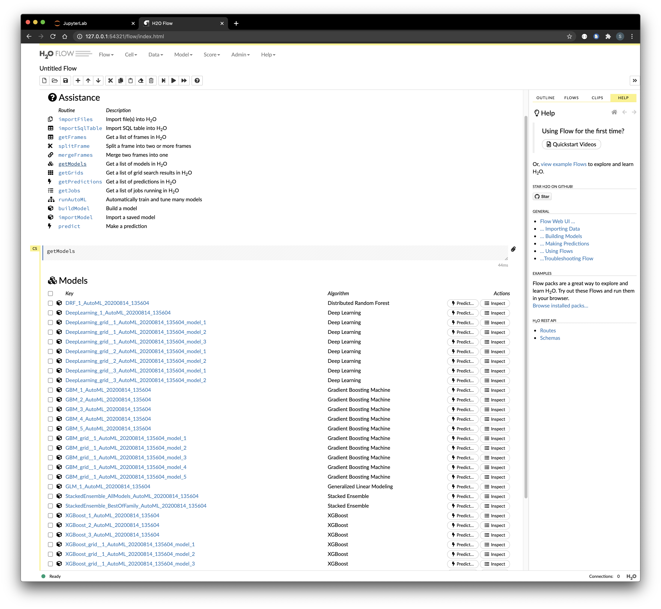
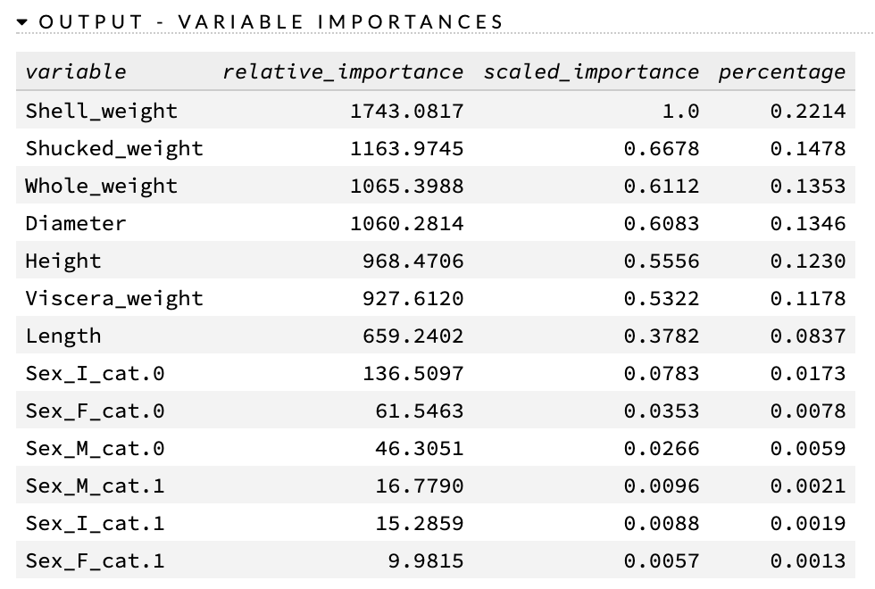
H2O AutoML: Web GUI
The web GUI can also provide detailed model info

Slide 30
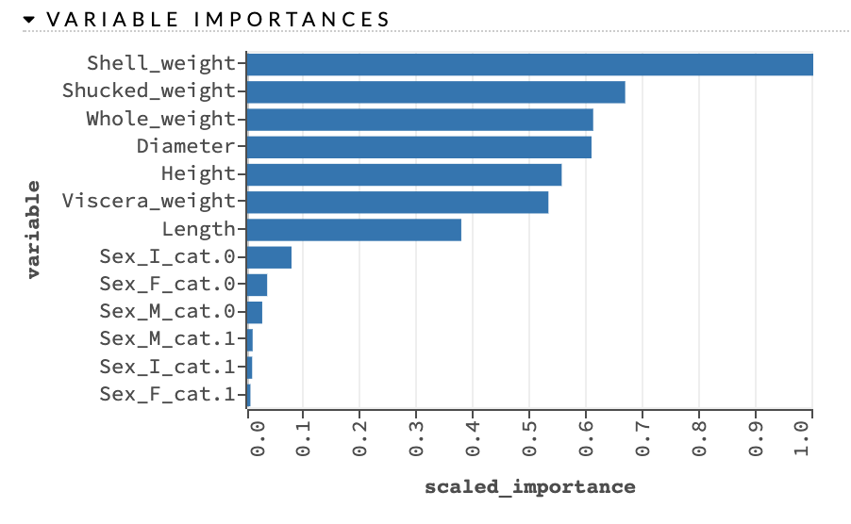
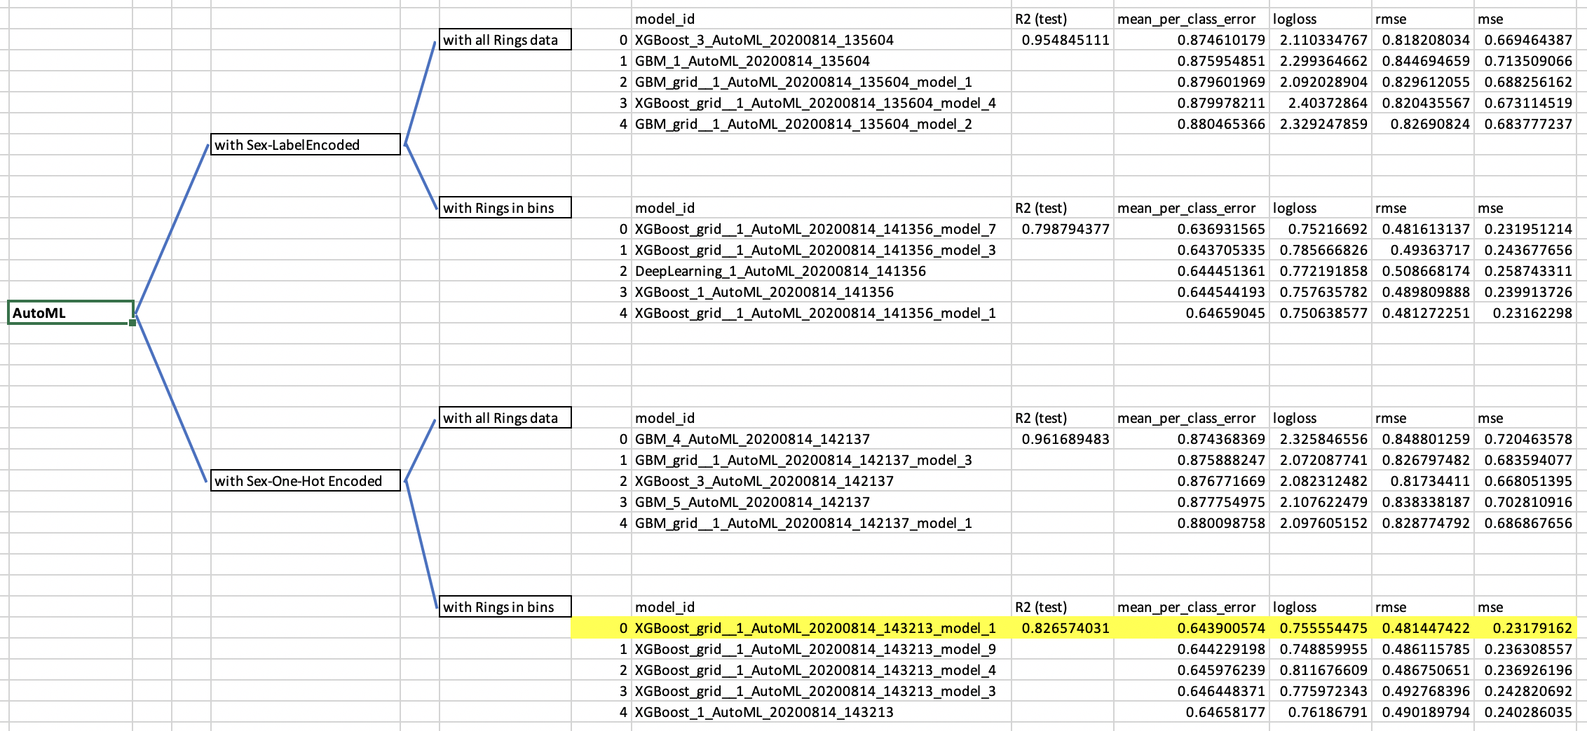
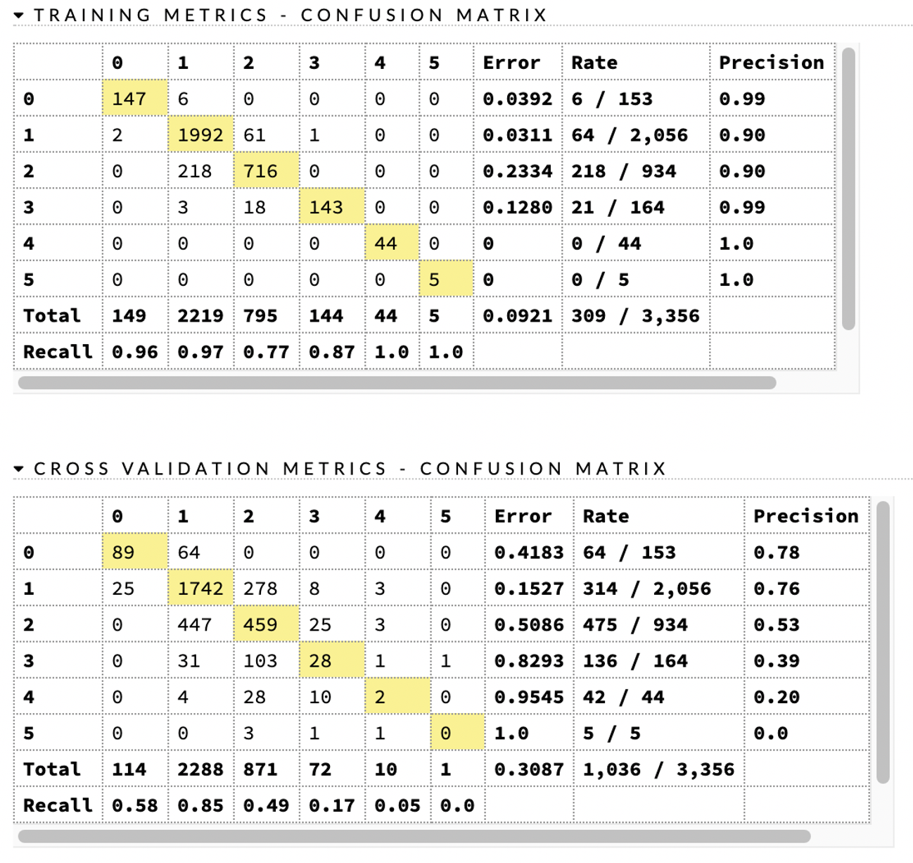

H2O AutoML: Modeling Plan and Results

Slide 31
Section break (Speaker change)

Slide 32
Neural Network Model Set-Ups
Tested
Deep versus Simple
Regression versus Classification
For just Regression, stratified versus unstratified
For Just Classification, bins versus no bins
Details about Set-Up
Simple Neural Networks had just one hidden layer
Deep Neural Network had four hidden layers
For classification with bins, bins were increments of 5 rings (1-5, 6-10, etc.)
Hidden Layer Nodes: 128 first layer, 256 latter layers
1,000 epochs; kernel regularized with l1 and l2 = 0.01 with exceptions

Slide 33
Neural Network Models Tested
Regression Models
Stratification? | Deep or Simple | L1, L2 Kernel Regularization | Last Epoch Loss | Training Loss | Test Loss | MSE | R-Squared
Y | Simple | 0.01 | 0.5362 | 0.5388 | 0.5493 | 0.53207 | 0.4680
N | Simple | 0.01 | 0.5345 | 0.5343 | 0.5455 | 0.5337 | 0.4583
Y | Deep | 0.01 | 0.9399 | 0.9450 | 0.9436 | 1.0821 | -0.0818
N | Deep | 0.01 | 0.9428 | 0.9395 | 0.9417 | 1.0754 | -0.0913
Y | Deep | 0.005 | 0.6424 | 0.6450 | 0.6567 | 0.5134 | 0.4868
N | Deep | 0.005 | 0.6421 | 0.6427 | 0.6549 | 0.5112 | 0.4812
Slide text
Classification Models
Bins? | Deep or Simple | Last Epoch Loss | Training Loss | Test Loss | Last Epoch Accuracy | Training Accuracy | Test Accuracy
Y | Deep | 1.2106 | 1.2099 | 1.2083 | 0.6082 | 0.6082 | 0.6086
N | Deep | 2.7034 | 2.7027 | 2.7016 | 0.1652 | 0.1652 | 0.1649
Y | Simple | 0.9768 | 0.9767 | 0.9923 | 0.6344 | 0.6421 | 0.6421
N | Simple | 2.4572 | 2.4564 | 2.4608 | 0.2298 | 0.2256 | 0.2119
Notes:
For the regression models of this data, stratification improved results across the board.
For the regression models of this data, the learning rate was initially too high. This caused the deep neural network to perform worse than the simple neural network, which was counter-intuitive. Lower the learning rate for the deep model improved its performance dramatically.
For the neural network classification of this data, the Deep and Simple models performed with similar accuracy. This could indicate that the additional hidden layers of the Deep models are not helpful and only the Simple model should be used to save computing power, or you could continue to adjust the learning rate with the kernel regularization.

Slide 34
Neural Network – Issues Encountered
For classification, Train-Test Split would often result in unequal numbers of output columns due to low quantity of data in some categories. This causes an error during testing.
To address this, stratification of the output variable (y) is used
However, stratification only works if each category has more than a single value.
To address this, all categories with only a single value were removed
Overfitting of models
Without regularizing the kernel, the later epochs had a very high accuracy while test data had a much lower accuracy indicating the model was overfitted to the training data despite being stratified. Adding kernel regularization solved the overfitting.
Learning Rate
Deep or simple model being better could depend on the learning rate

Slide 35
Section break (Speaker change)

Slide 36
Summary
Slide text

Slide 37
Next Steps
Build a full-stack website to receive user-entered abalone characteristics and then predict the abalone age with different models

Slide 38

Any questions?

